Slide 1
Auxiliary Outreach
2023-2024 Department of Michigan
Chairman Jared Blum
Banding Together for Our Veterans, the Angels Among Us

Slide 2
Auxiliary Outreach
Building Partnerships
Vote on opportunity in your meeting & record in your minutes
One-time event or regularly scheduled activity
Auxiliary members are only volunteers
One member or many may participate in the volunteer opportunity

Slide 3
Auxiliary Outreach is…
When an Auxiliary member, group or members or an entire Auxiliary volunteers for an organization outside of our own
Examples
Working with parks and recreation departments
Working with firefighters on fire safety
Participate in walks that benefit other organizations
Handing out food at soup kitchens
Delivering food for Meals on Wheels
And many more!

Slide 4
Auxiliary Outreach is not…
Volunteer work that is performed for the benefit of the Post or Auxiliary
Examples
Repairs or maintenance to the Post home
Cooking or serving a meal for a Post or Auxiliary fundraiser
“Buddy” Poppy distribution
VFW or Auxiliary meetings, conventions, conferences or school of instruction

Slide 5
Partnership Opportunities
Ask your membership
Reaching into your communities
Health Organizations
Schools
Recreation Groups
Senior Centers
Youth Groups
Other Nonprofits

Slide 6
Partnership Opportunities
Youth
Tutor students
Volunteer with after-school programs
Senior Citizens
Read to residents in a nursing home
Drive senior citizen to doctor appointments
Animals and the Environment
Clean or plant flowers in a local park
Take care of animals at an animal shelter
Hungry and/or Homeless
Volunteer at a soup kitchen or food pantry
Help organize/sort donations at a homeless shelter

Slide 7
Reporting
Motion to accept volunteer hours for Auxiliary Outreach
Indicate the project that your Auxiliary has accepted to do. You want to make sure everyone is on the same page and approves what you are volunteering to do
Auxiliary participated in Auxiliary Outreach. Volunteerism that benefits the community at large, assisting individuals with special needs or the elderly, etc. REPORT NUMBER OF MEMBERS AND HOURS!
Indicate in your reporting the project that you did, how many members participated and the numbers of hours completed

Slide 8
Reporting
another organization not affiliated with the VFW or VFW Auxiliary
Citation to every Auxiliary that partners with another organization within their community
Auxiliaries must send the entry form to chairman by March 31, 2024
Achievements | Completed | Reported
Auxiliary utilized the Auxiliary Outreach material/resources available in MALTA Member Resources.
Did your Auxiliary as a group, volunteer or partner with another organization not affiliated with the VFW or VFW Auxiliary.
How many different Organizations did your Auxiliary volunteer or partnered with during the year? First Responders-Churches-Churches-Towns-Disaster Relief-Cancer, Heart, ALS, Associations, etc.-Other
Number of combined member and/or Auxiliary hours volunteered with another organization not affiliated with the VFW or VFW Auxiliary

Slide 9
Important Details
Show your PRIDE, wear something Auxiliary-branded
Not appropriate to openly recruit for membership at the event
Have membership information available should someone ask

Slide 10
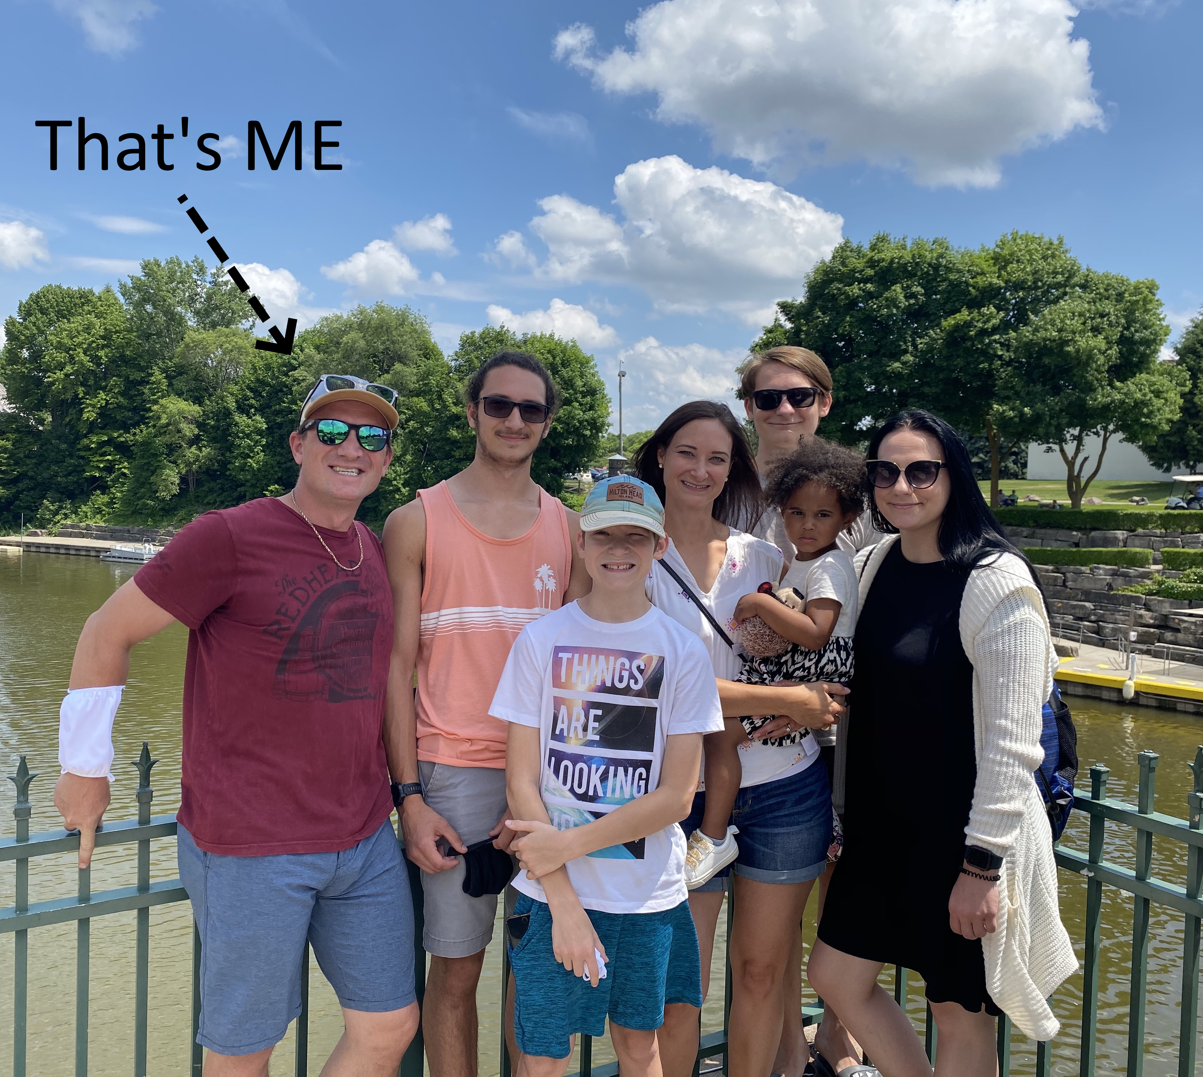
Contact Information
JBLUM25@GMAIL.COM
734-771-3050

